Slide 1


Strategic Plan Update
Campus Master Plan Highlights
SCOTT BARDWELL

Slide 2
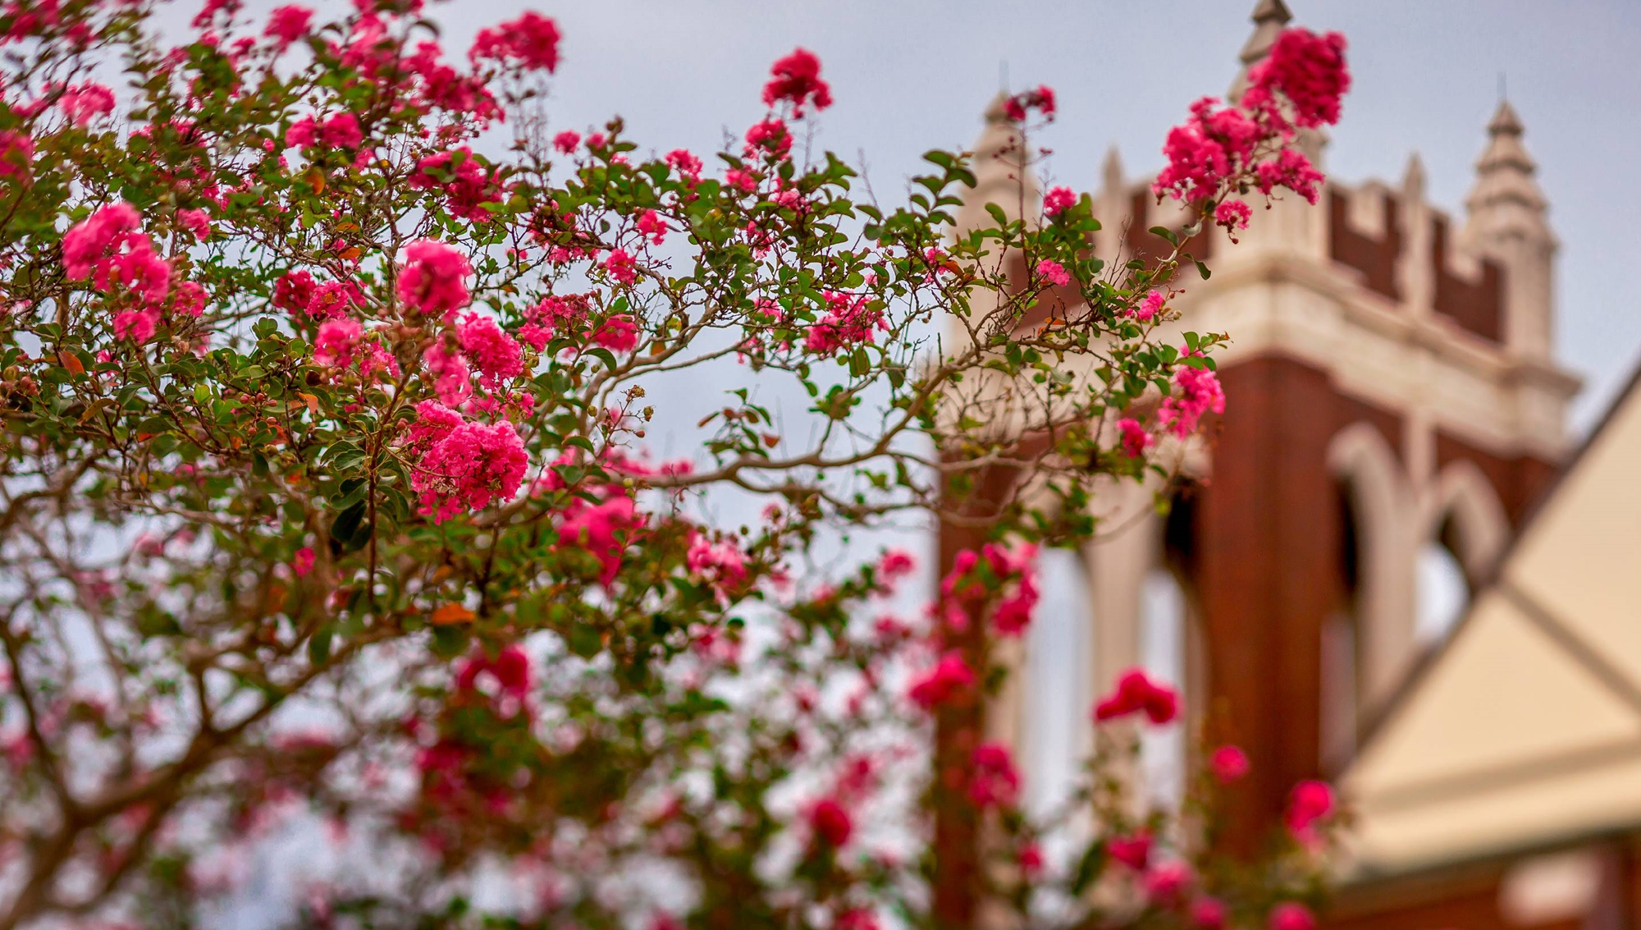

COMMITTEE MEMBERS
Will Adams
Scott Bardwell
Gary Black
Debbie Copeland
Brett Furr
Allison Keppinger
Pat Kerr
Heather Kirkpatrick
Laurie Lemoine
Sally McBride
Keely McMillin
Dan Zito

Slide 3
Met with focus groups
Met with staff resources
Made a physical assessment of
all buildings and property
The Last
Year . . .

Slide 4
6
Stakeholder Groups
+ College of Elders
Stakeholder
Engagement
72
Stakeholder
Participants
432
Active
Responses

Slide 5
Selected Tipton Associates
Developed a “Blueprint for Growth”
Adopted by the Session in January 2026
The Last
Year . . .

Slide 6
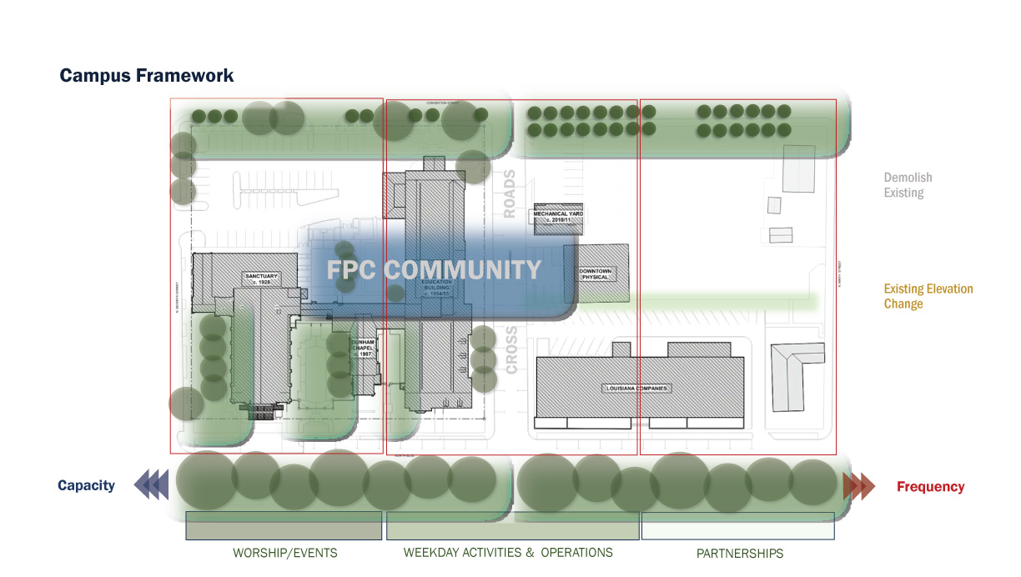

Slide 7
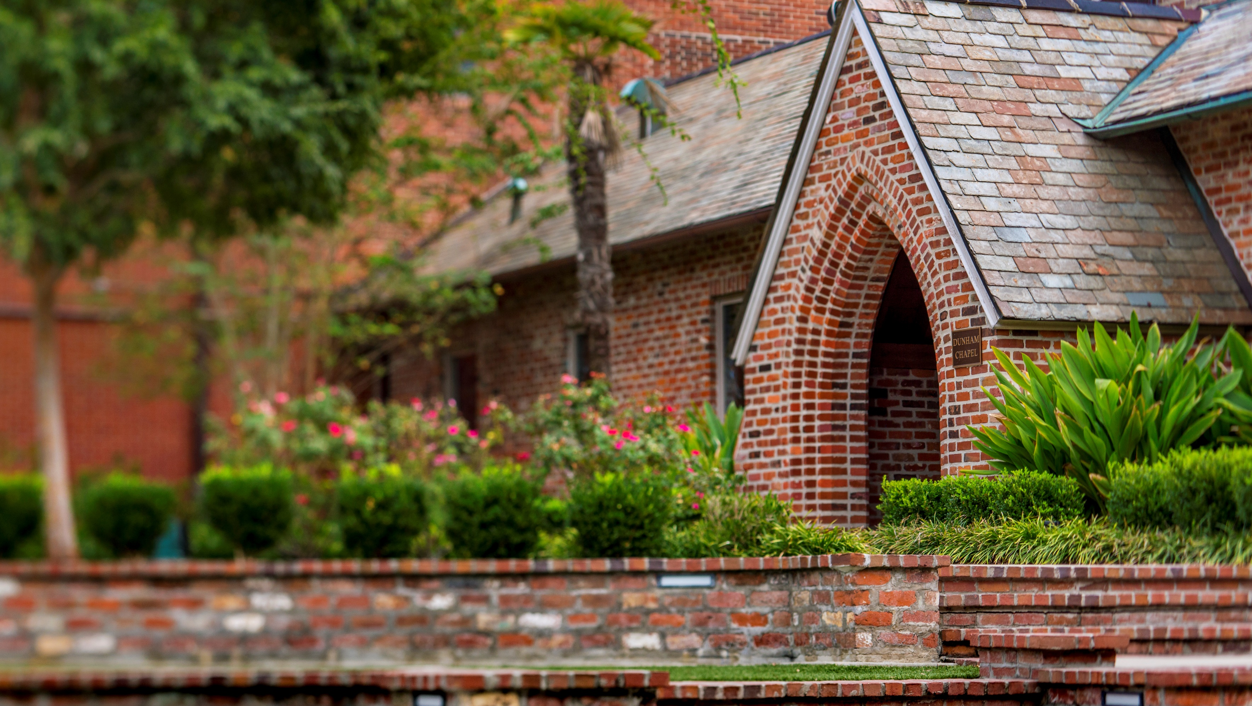
Additional parking
A shift in ministry locations to
achieve goals and allow room
for growth
Simplification of access to ensure
security and wayfinding
New
Property
Advantages

Slide 8
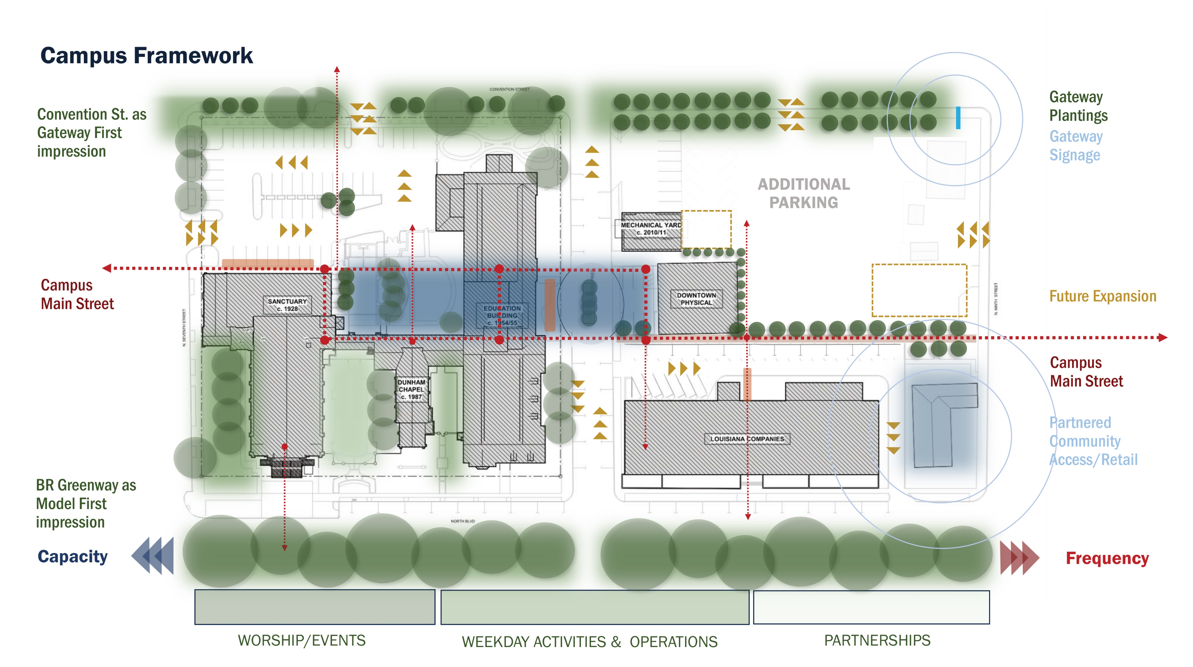

Slide 9
Intentional spaces to connect
around ministries and hospitality
Clear wayfinding
More efficient use of spaces
Programmatic
Moves Allow for:

Slide 10
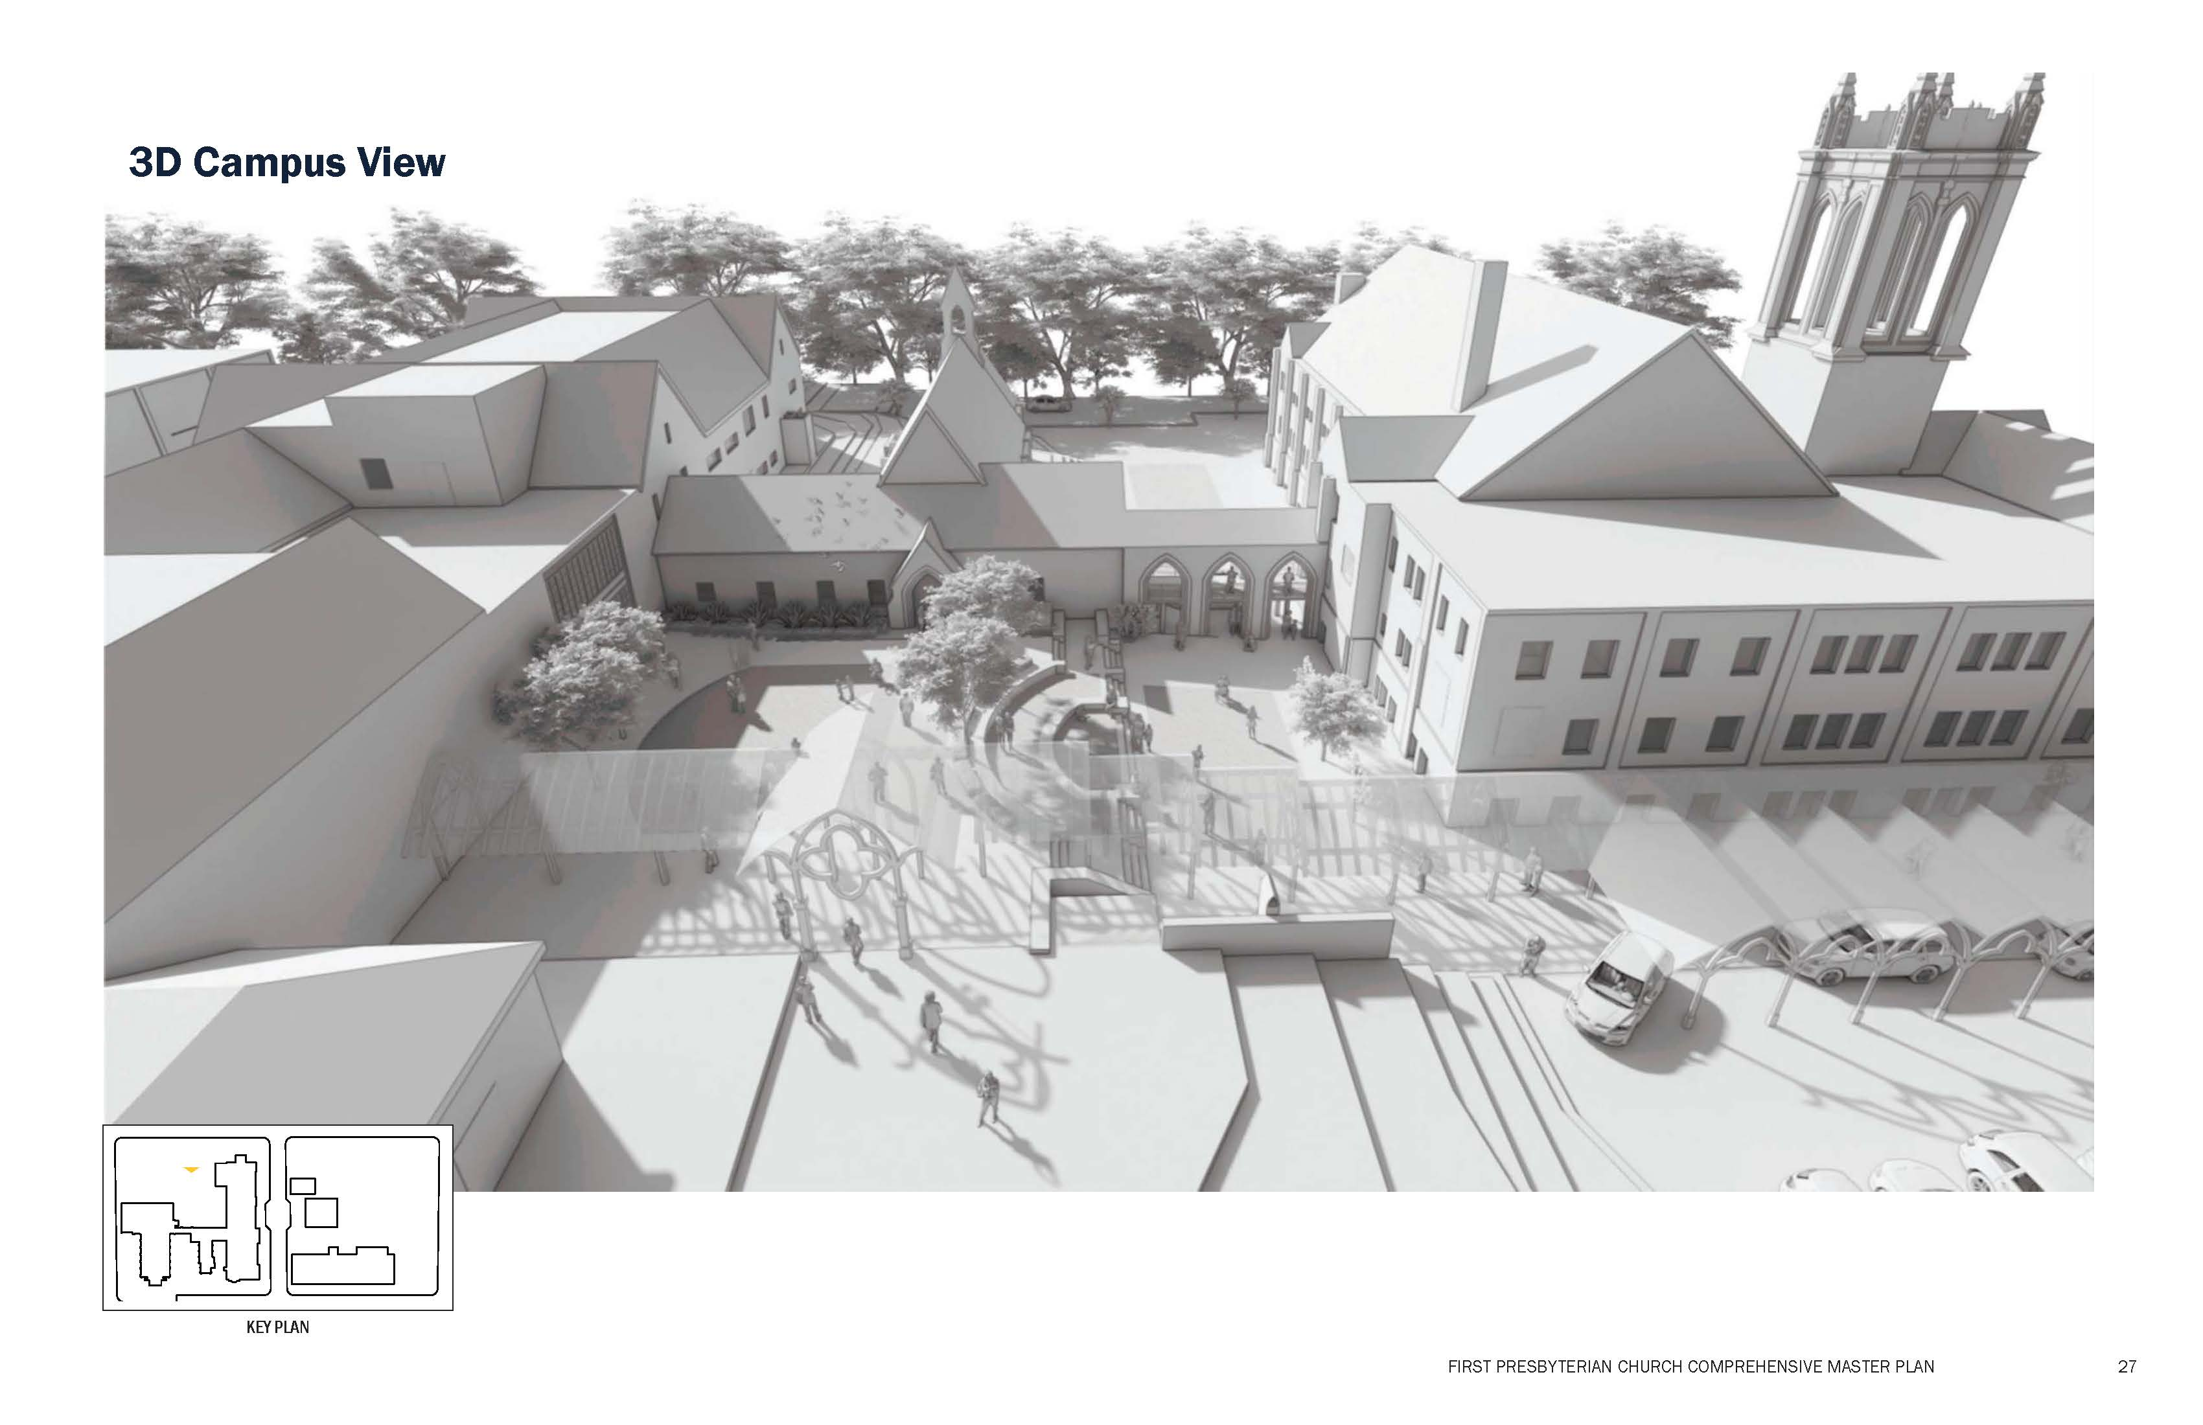

Slide 11
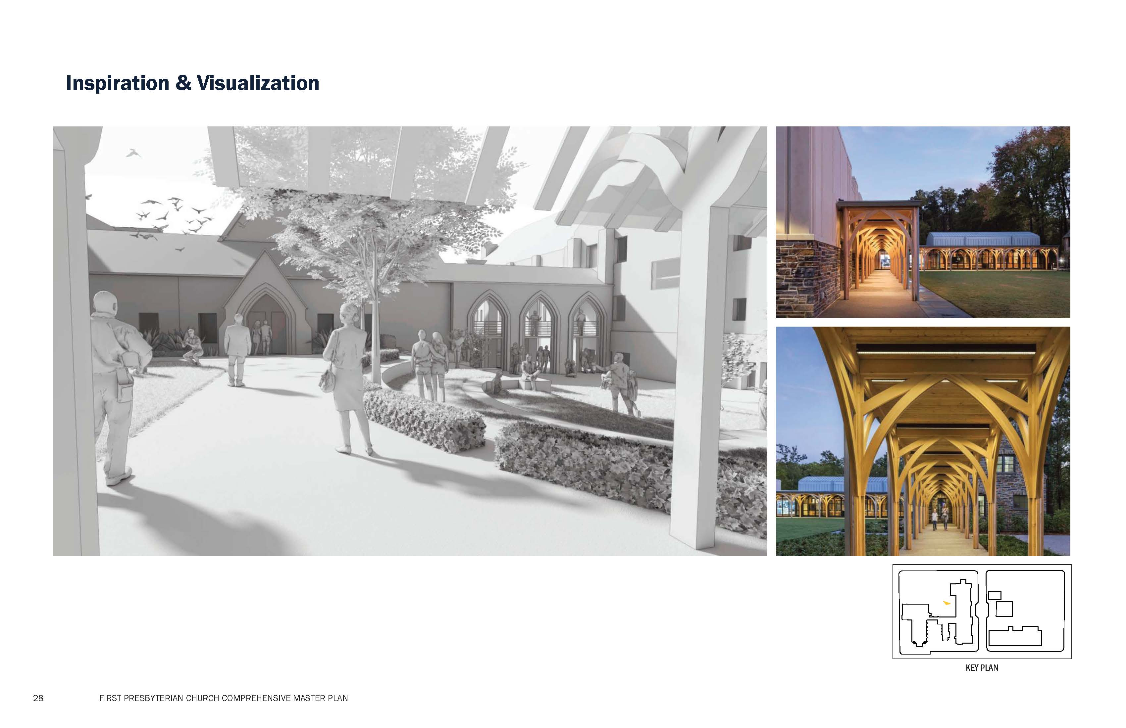

Slide 12
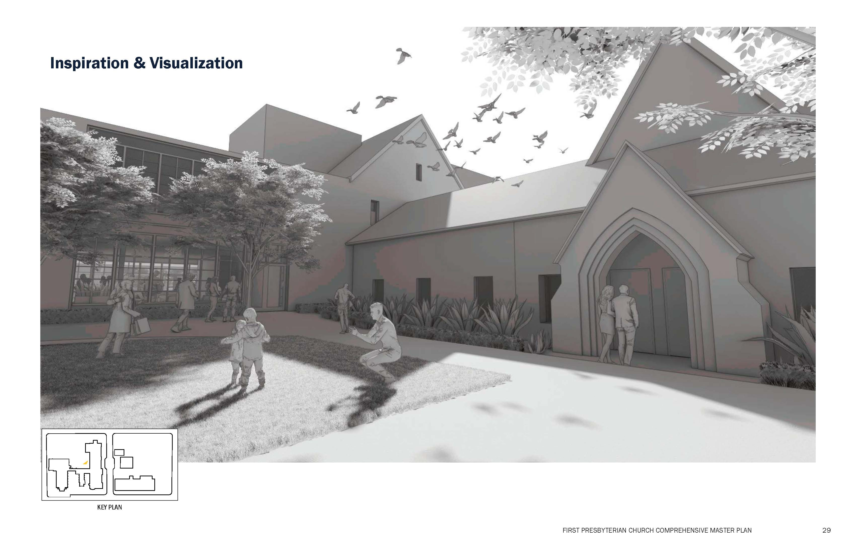

Slide 13
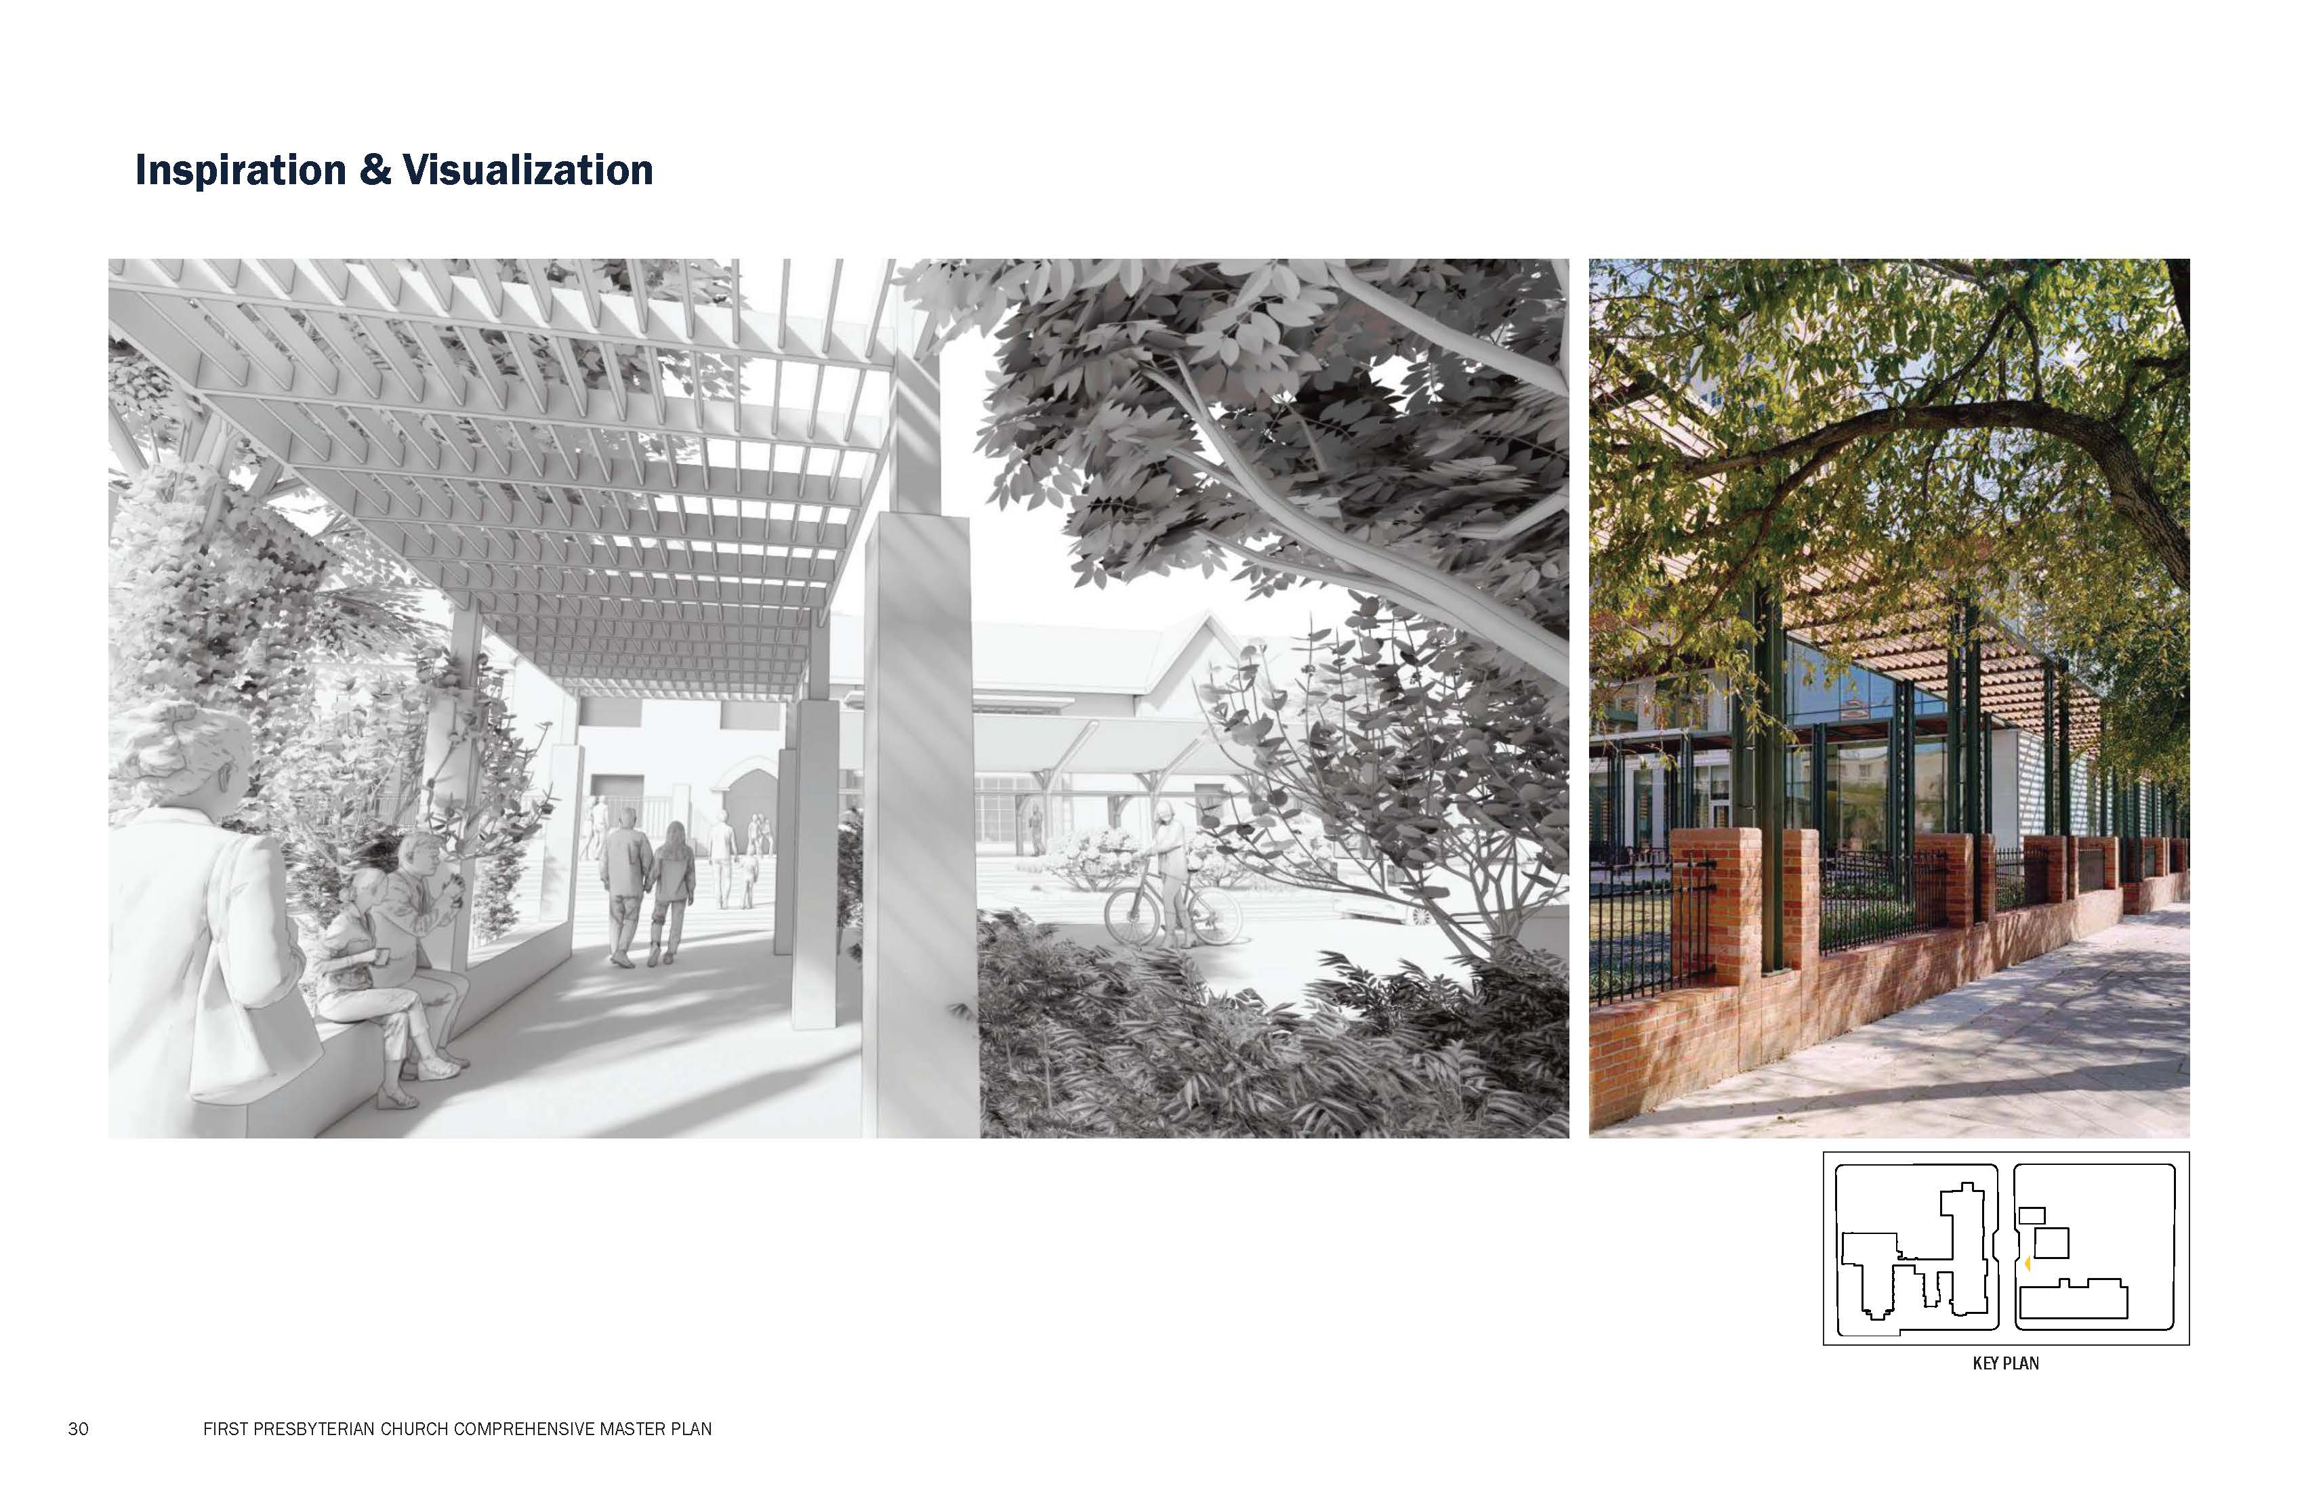

Slide 14
Establish Implementation Committee
3-5 years to analyze the
recommendations
Create budget
Plan renovation phases
Oversee construction
Next Steps

Slide 15
Methodical and long-term
Identify scope and budget
Raise funds
Complete scope and fundraising
Within 5 years
Timeline

Slide 16
pray
serve
GET INVOLVED!
give
suggest

Slide 17
pray
serve
GET INVOLVED!
give
suggest

